Slide 1
Relational Database Service (RDS)
All about Relational Database Service (RDS)

Slide 2
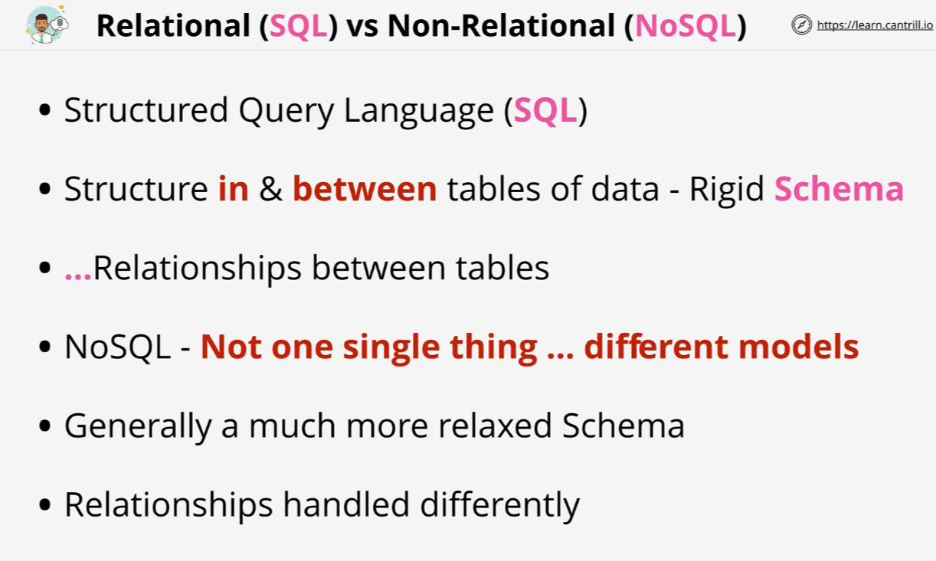
SQL vs NOSQL

Slide 3
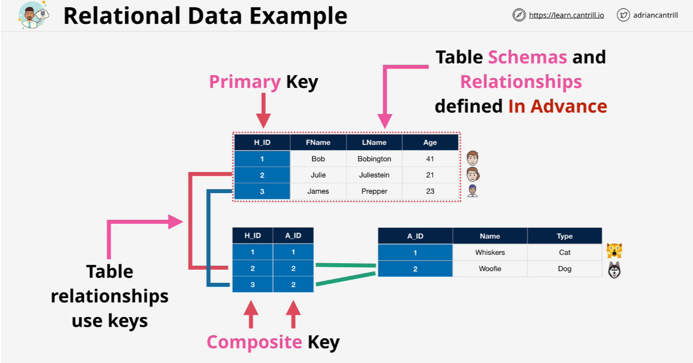
Relational Data Example

Slide 4
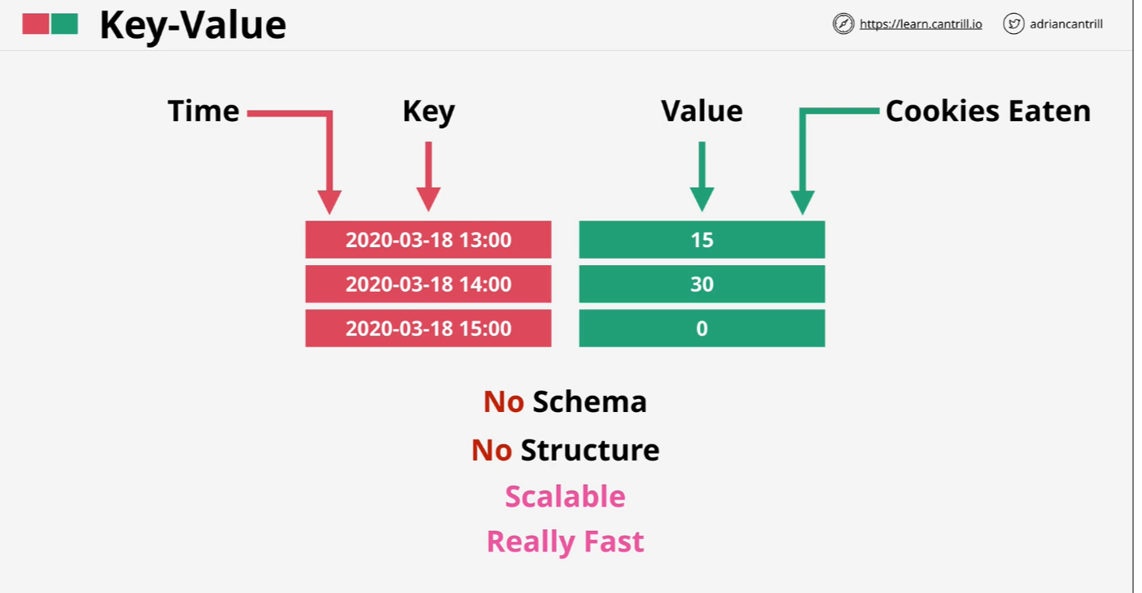
NOSQL Key-Value

Slide 5
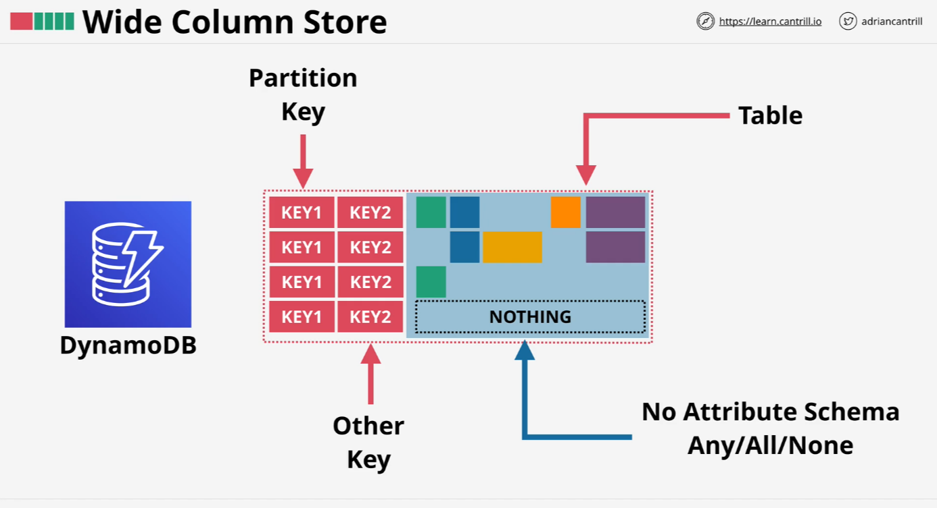
NOSQL Wide Column

Slide 6
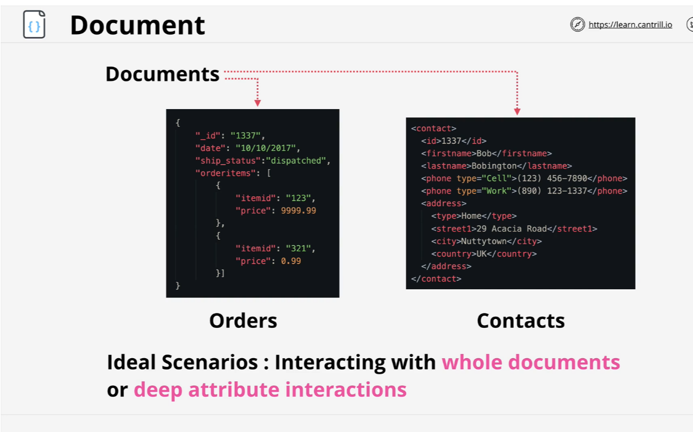
NOSQL Document

Slide 7
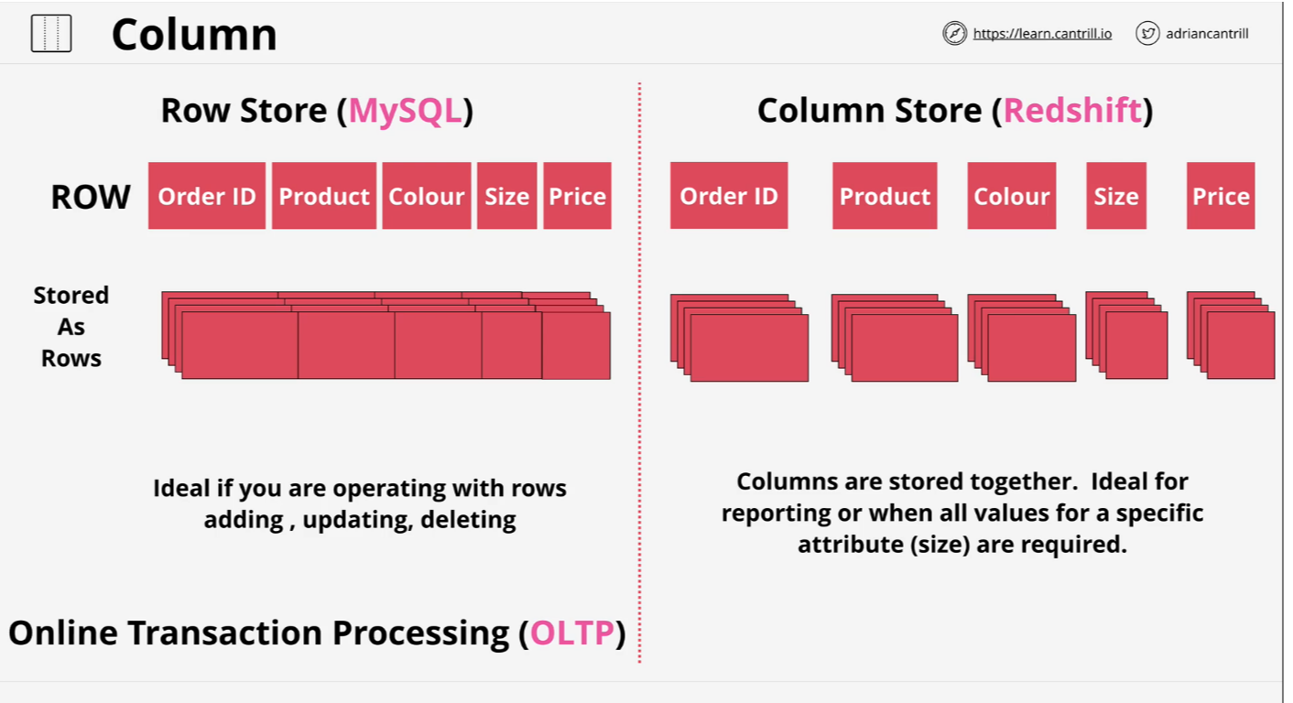
NOSQL Column Databases

Slide 8
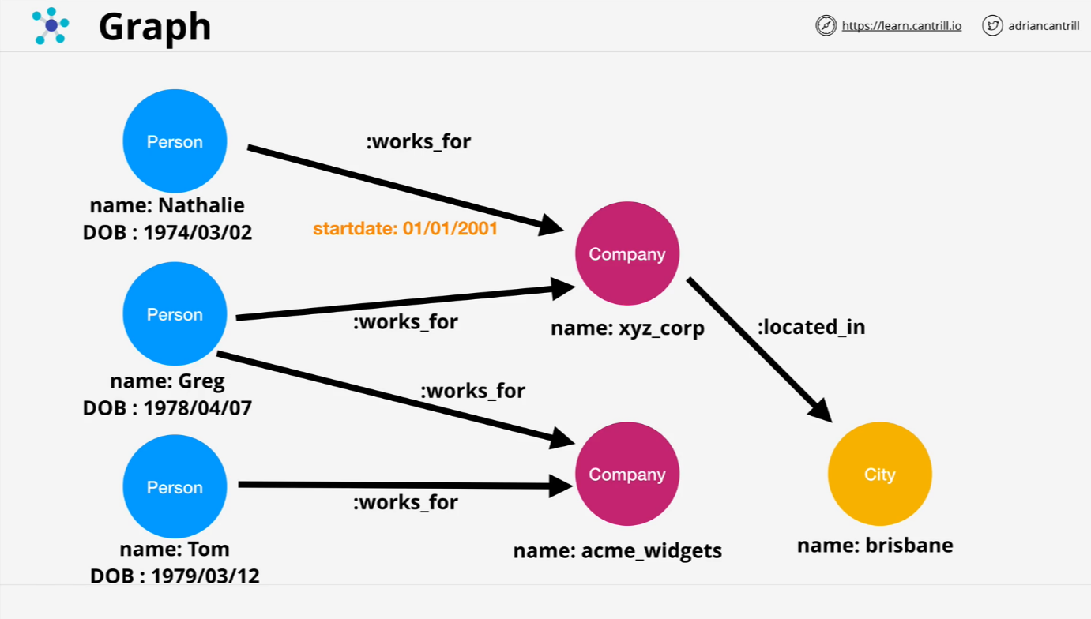
NOSQL Graph

Slide 9
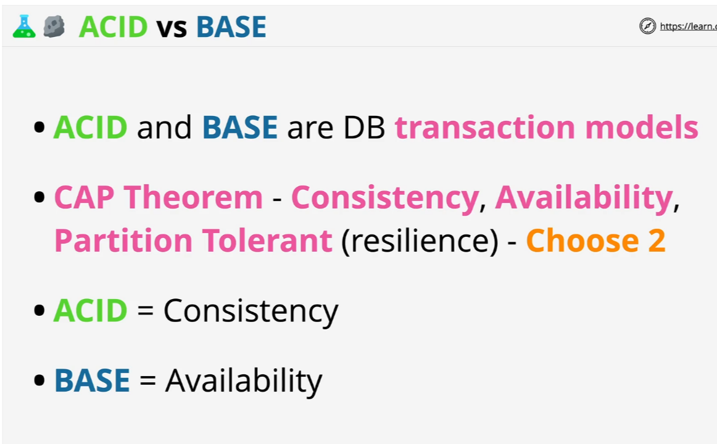
Acid vs Base

Slide 10
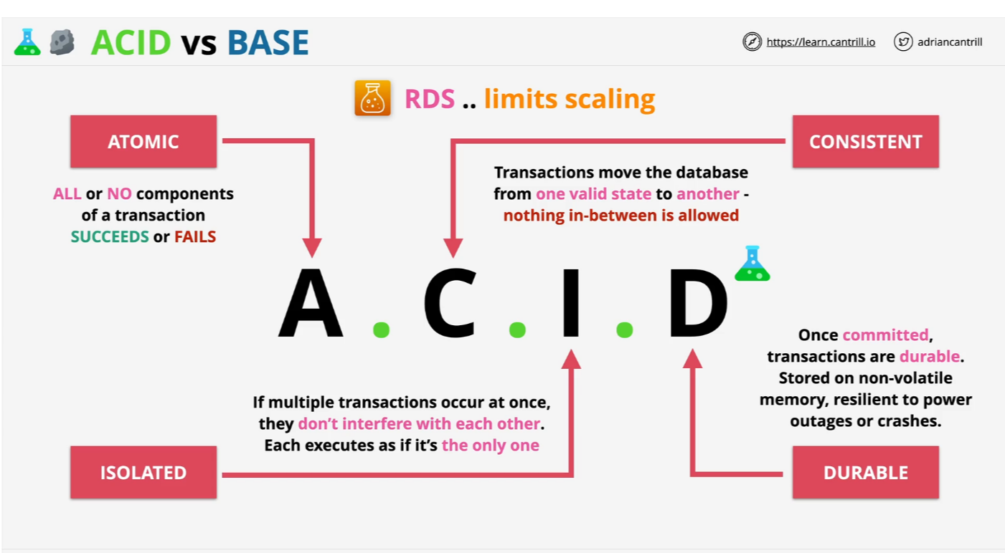
ACID vs BASE

Slide 11
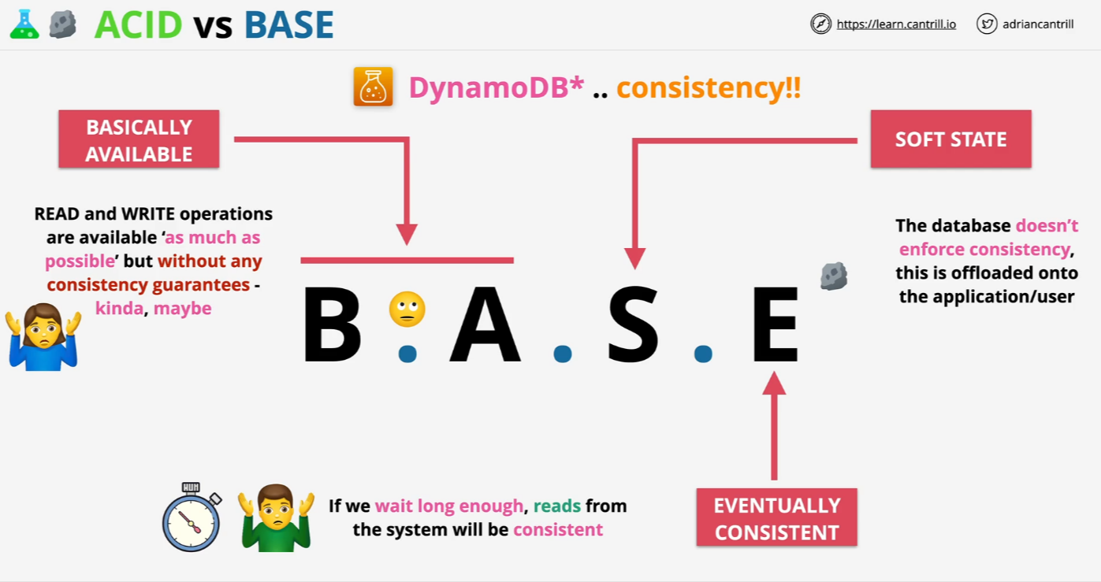
ACID vs BASE

Slide 12
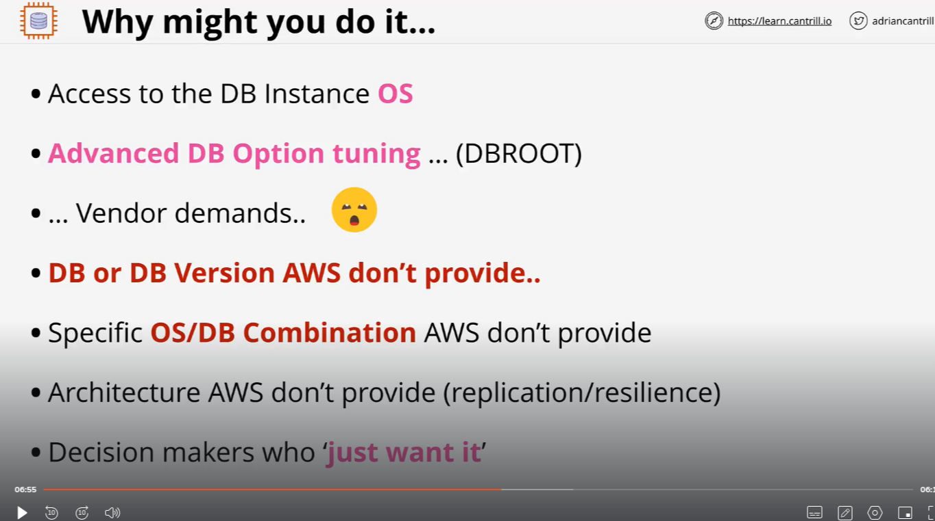
Databases on EC2

Slide 13
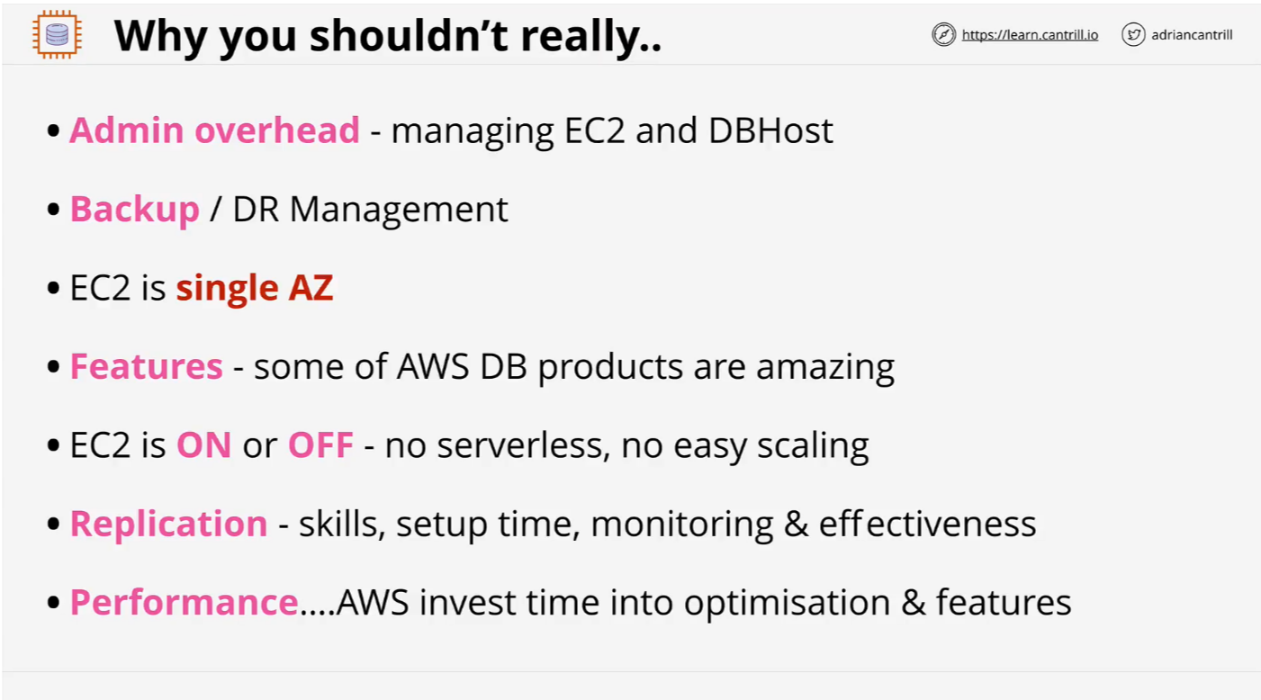
Databases on EC2

Slide 14
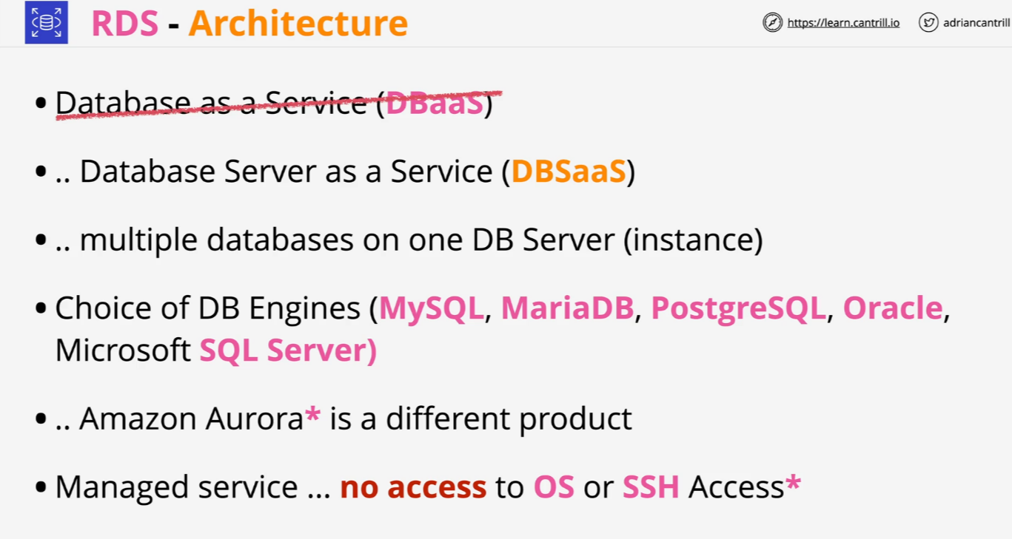
Relational Database Service (RDS) Architecture

Slide 15
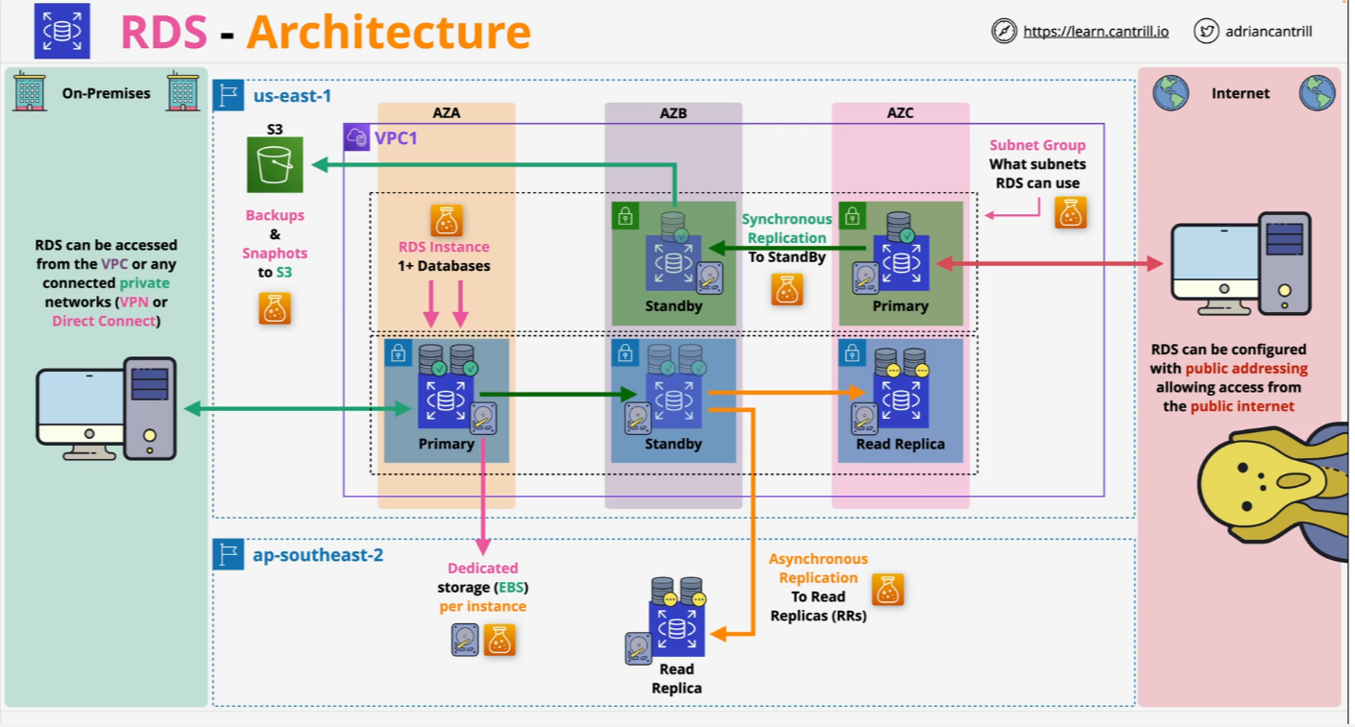
Relational Database Service (RDS) Architecture

Slide 16
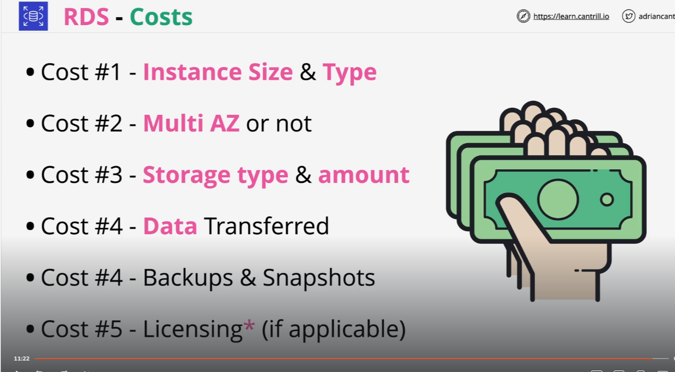
Relational Database Service (RDS) Architecture

Slide 17
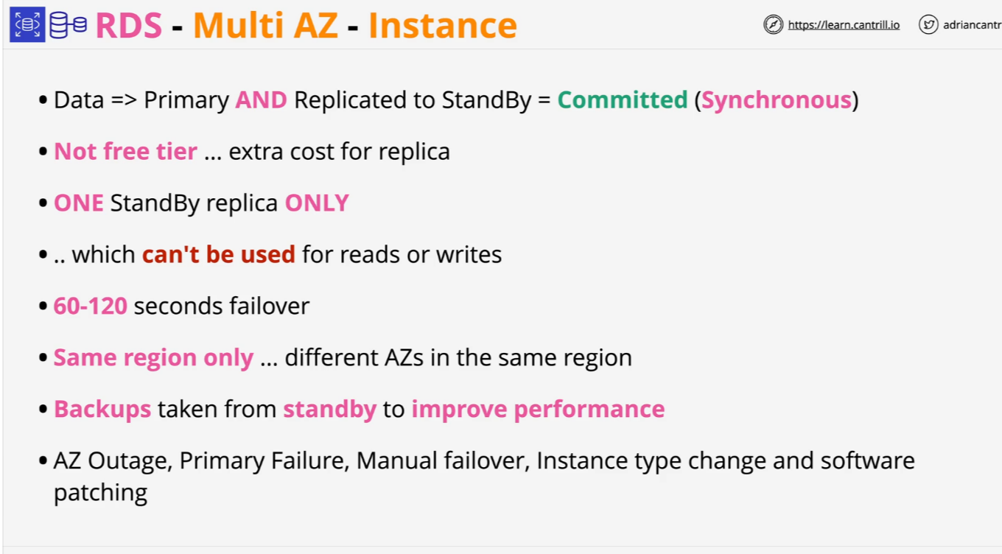
RDS MultiAZ - Instance

Slide 18
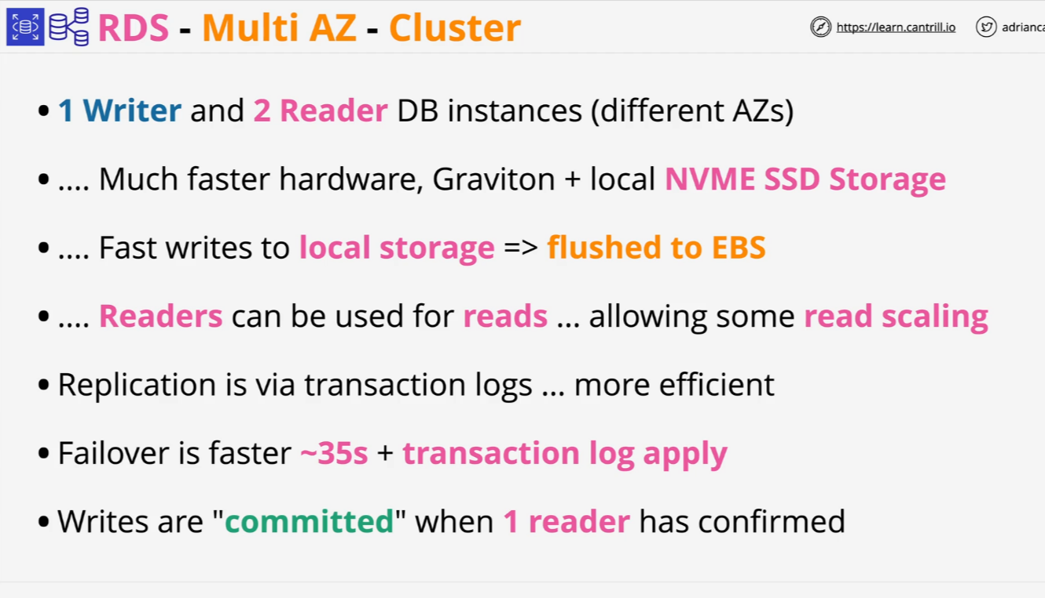
RDS MultiAZ - Cluster

Slide 19
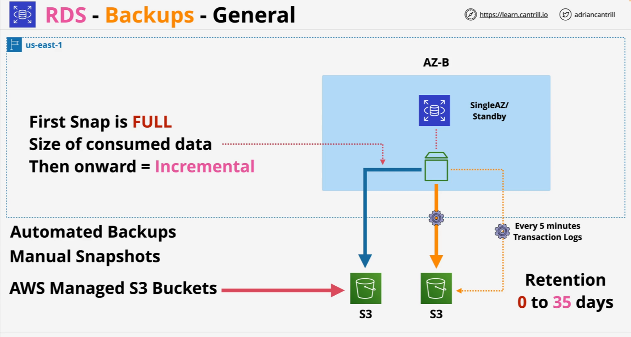
RDS Automatic Backup

Slide 20
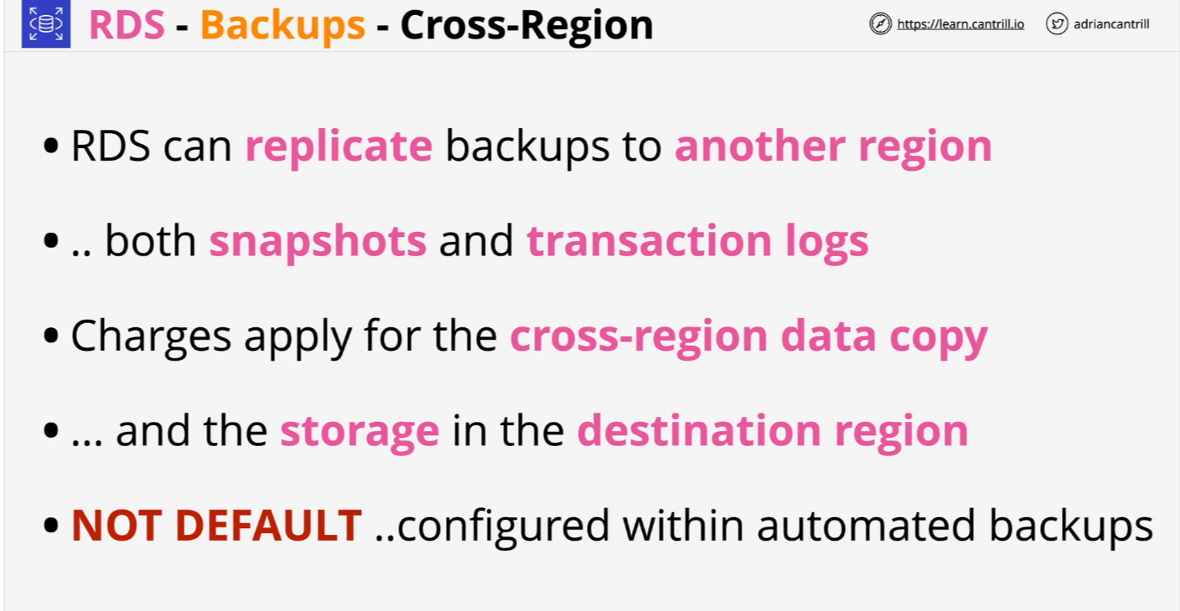
RDS Automatic Backup

Slide 21
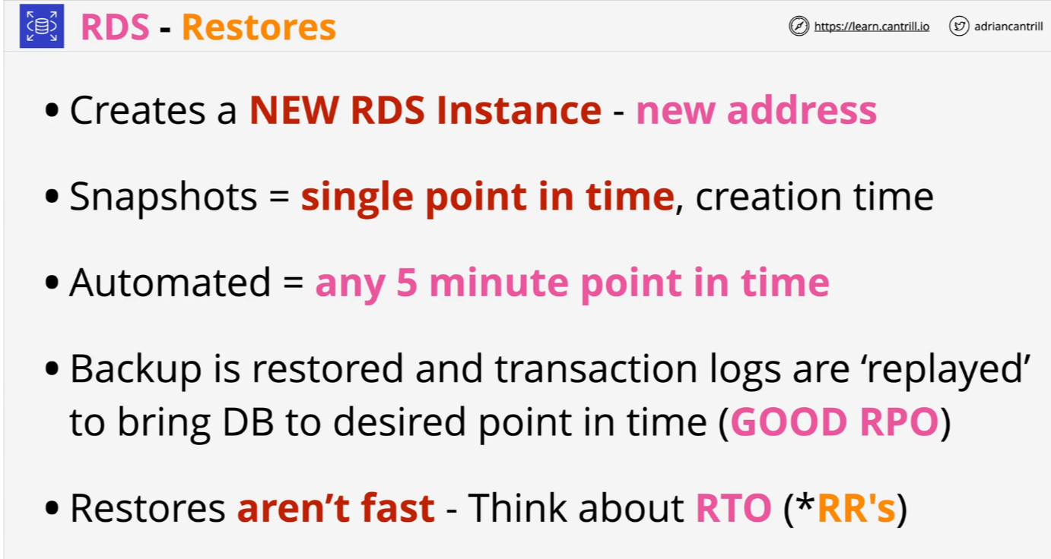
RDS Snapshots and Restore

Slide 22
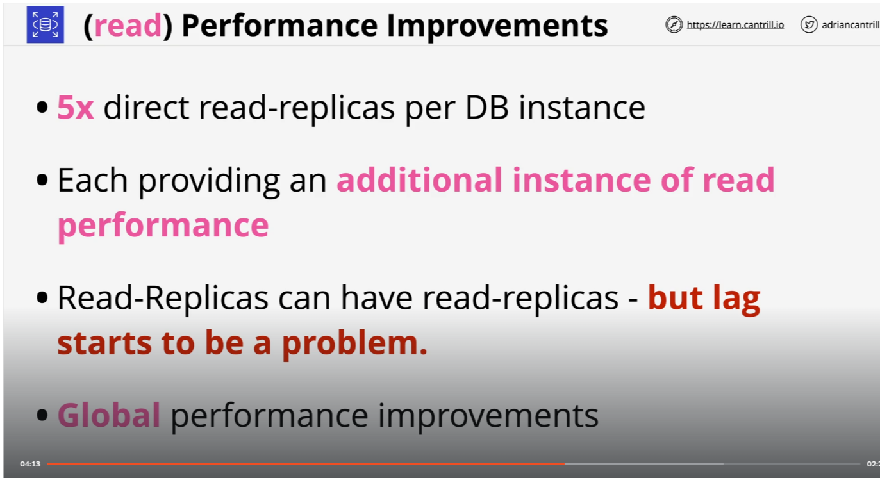
RDS Read-Replicas

Slide 23
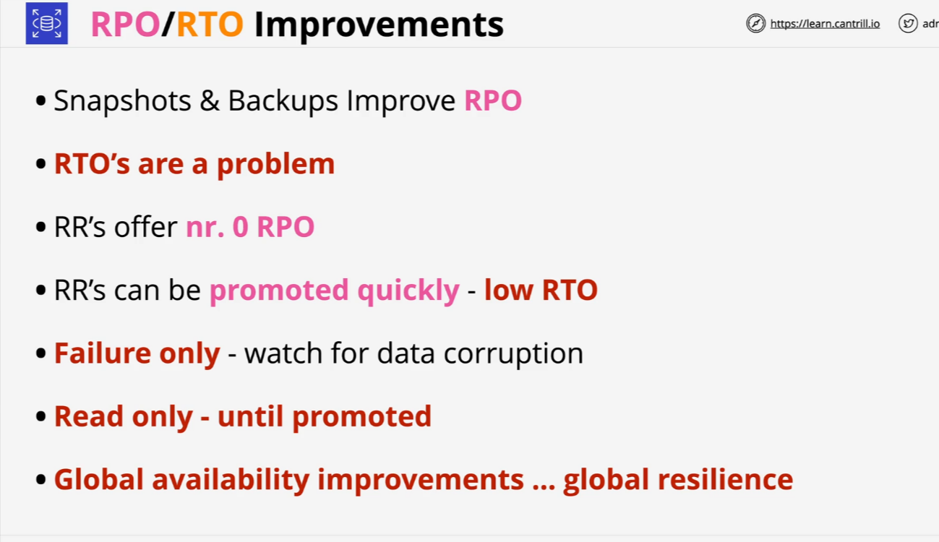
RDS Read-Replicas

Slide 24
RDS Read-Replicas
Amazon RDS Read Replicas are read-only copies of your primary database instance that enhance performance and scalability for read-intensive workloads. They are created through asynchronous replication from the primary instance, allowing you to distribute read traffic across multiple replicas.
Key Features:
Improved Read Performance: By directing read queries to read replicas, you can reduce the load on your primary database, leading to better performance for both read and write operations.
Scalability: You can create multiple read replicas within the same AWS Region or across different Regions, enabling your application to handle increased read traffic and providing low-latency access to data for global users.
Disaster Recovery: In the event of a primary instance failure, a read replica can be promoted to a standalone database instance, providing a recovery solution.

Slide 25
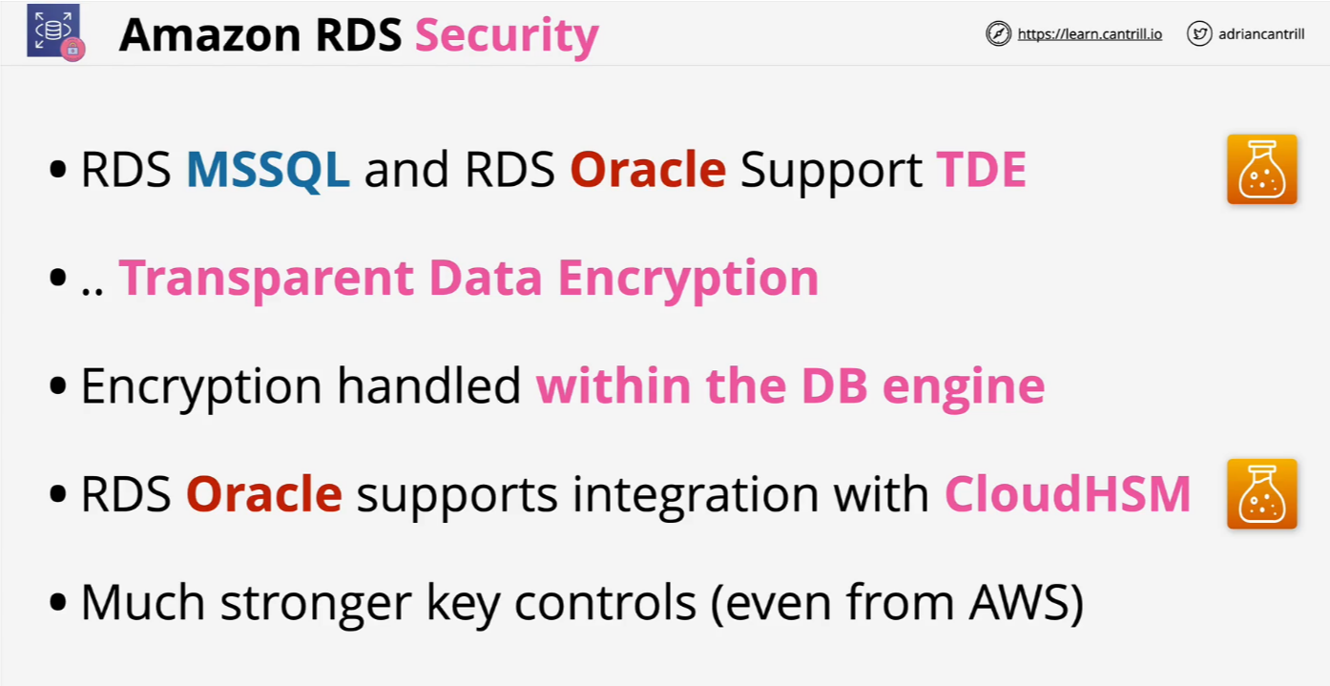
RDS Data Security

Slide 26
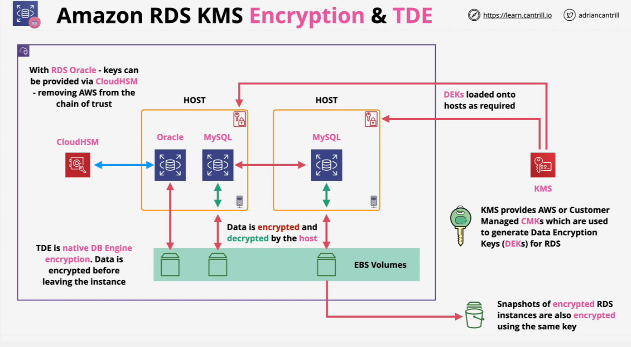
RDS Data Security

Slide 27
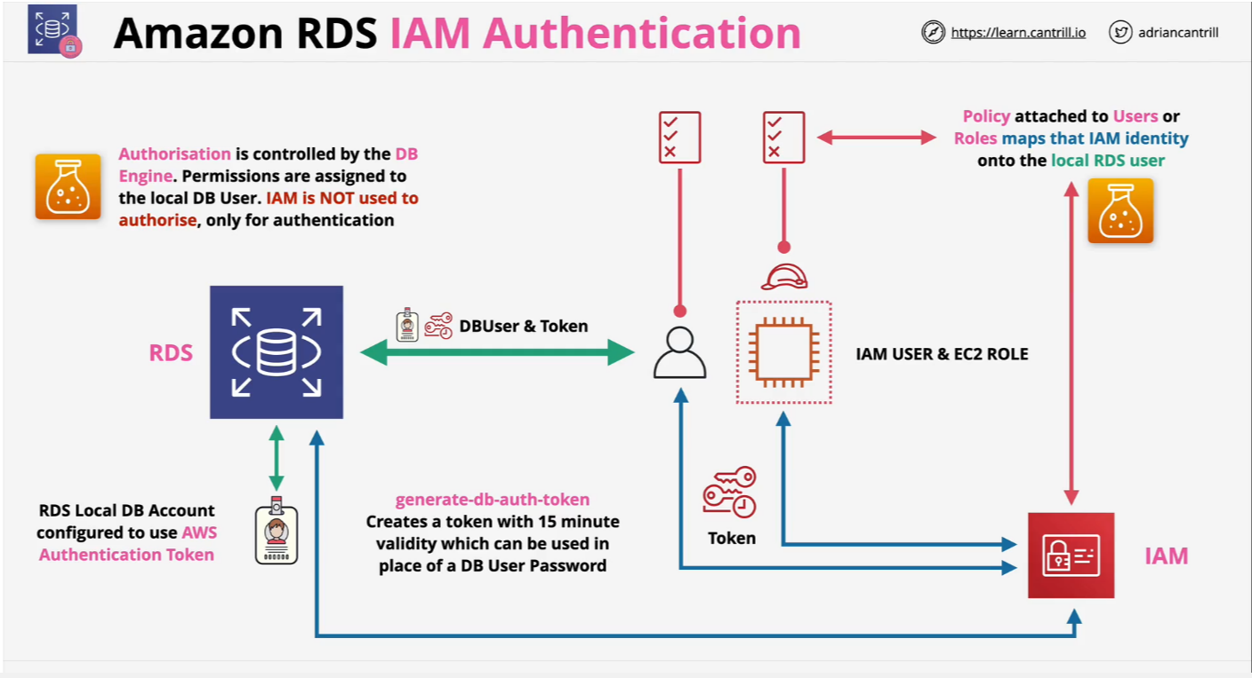
RDS Data Security

Slide 28
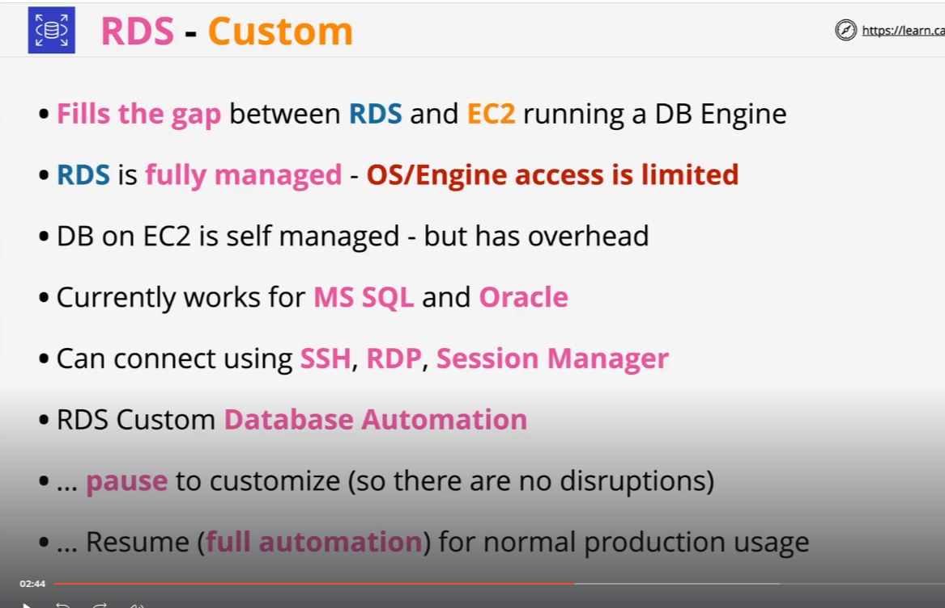
RDS Custom

Slide 29
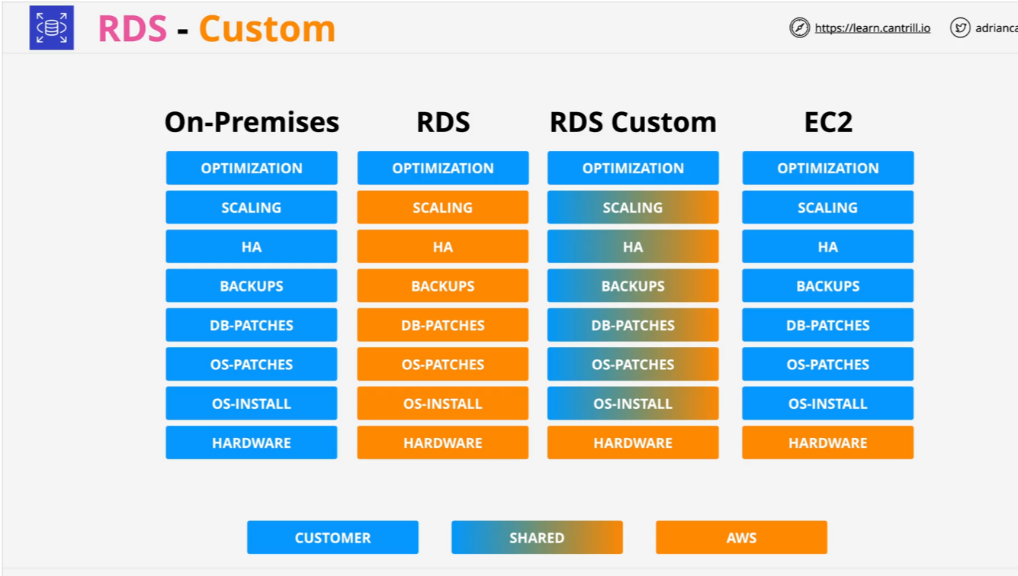
RDS Custom

Slide 30
RDS Custom
Amazon RDS provides comprehensive security features to protect your data:
Encryption at Rest: Data, including backups and snapshots, is encrypted using the industry-standard AES-256 algorithm, with keys managed through AWS Key Management Service (KMS).
Encryption in Transit: Secure Socket Layer (SSL) and Transport Layer Security (TLS) protocols encrypt data during transmission between your application and the RDS instance.
Access Control: Integration with AWS Identity and Access Management (IAM) allows for fine-grained permissions, and database-specific authentication methods enhance security.
Network Isolation: Deploying RDS within an Amazon Virtual Private Cloud (VPC) enables control over network access, and security groups manage inbound and outbound traffic.
Monitoring and Auditing: AWS CloudTrail logs API calls for auditing, and Database Activity Streams provide real-time monitoring of database activities.

Slide 31
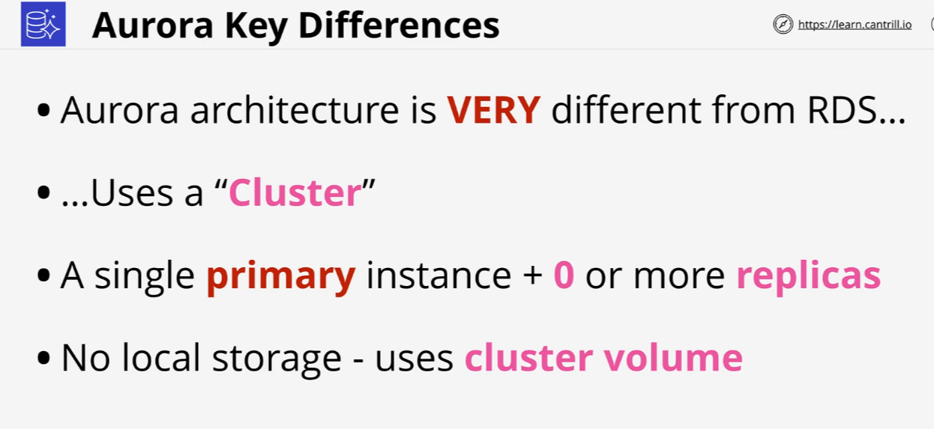
Aurora Architecture

Slide 32
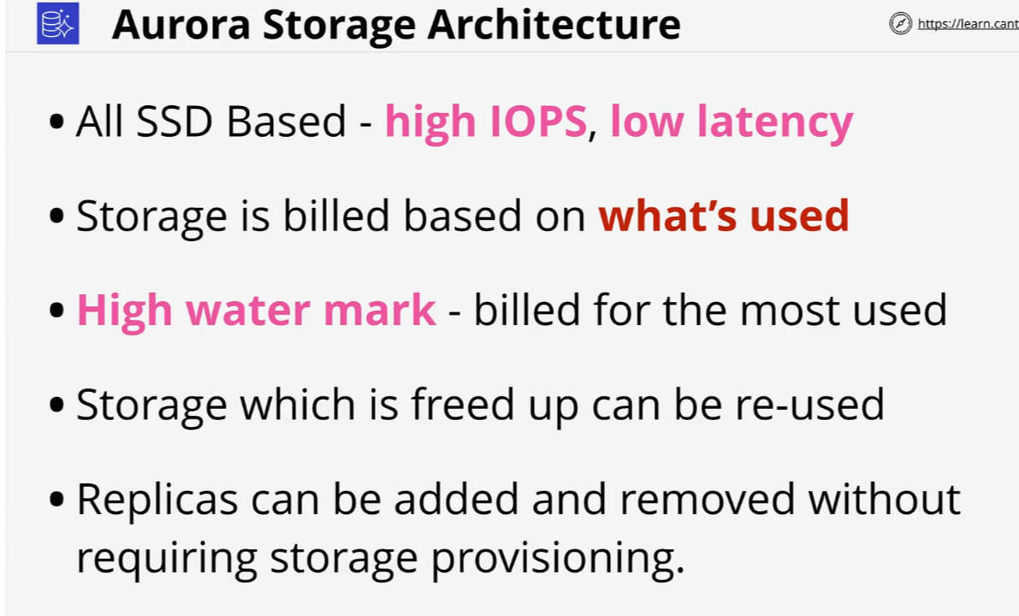
Aurora Architecture

Slide 33
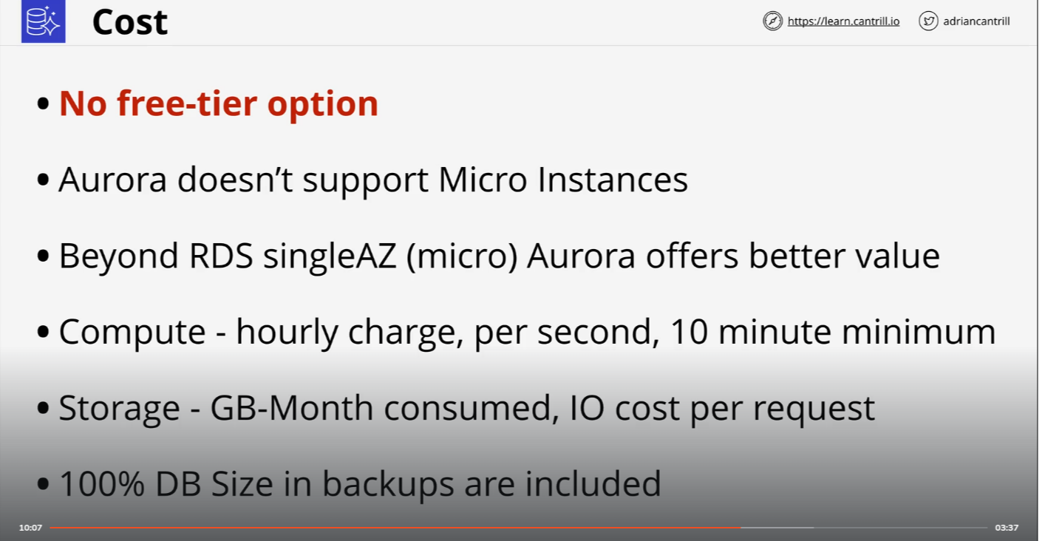
Aurora Architecture

Slide 34
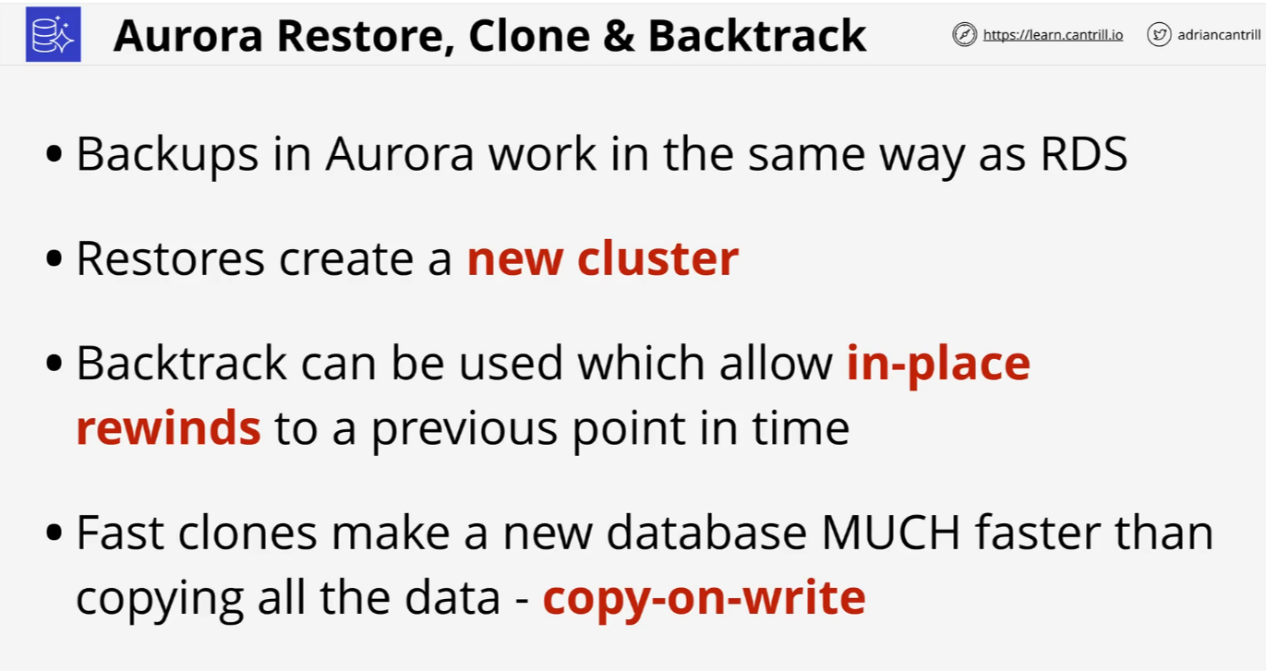
Aurora Architecture

Slide 35
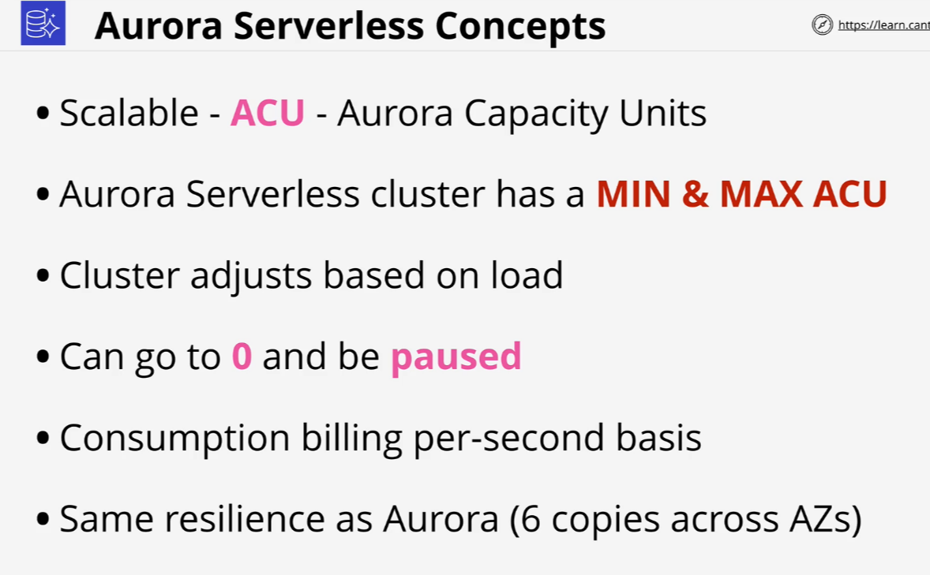
Aurora Serverless

Slide 36
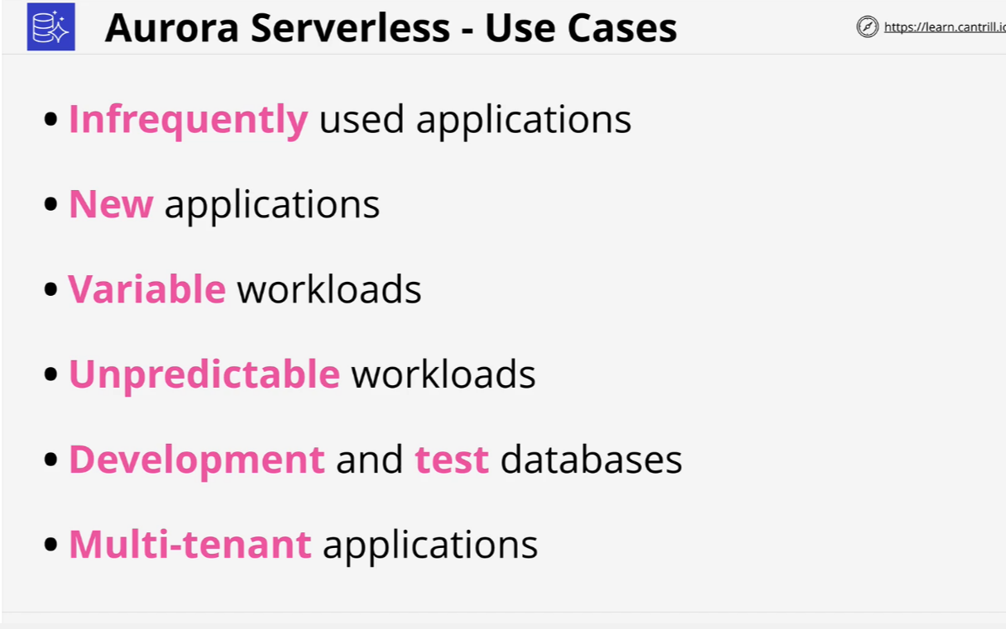
Aurora Serverless

Slide 37
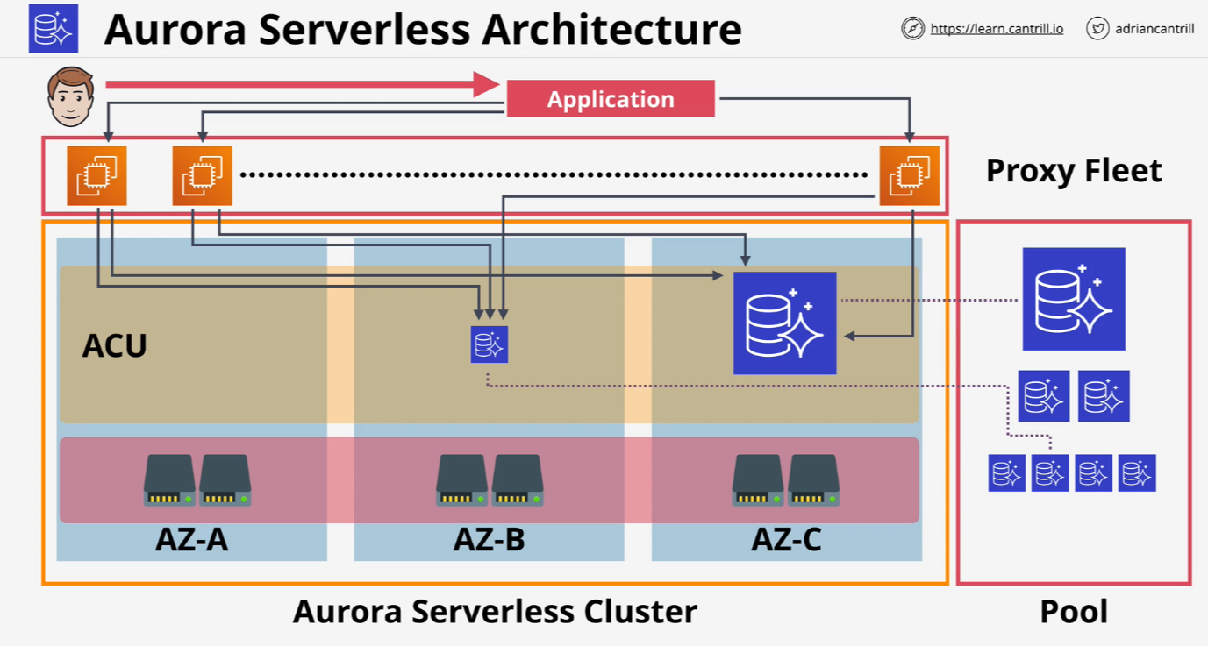
Aurora Serverless

Slide 38
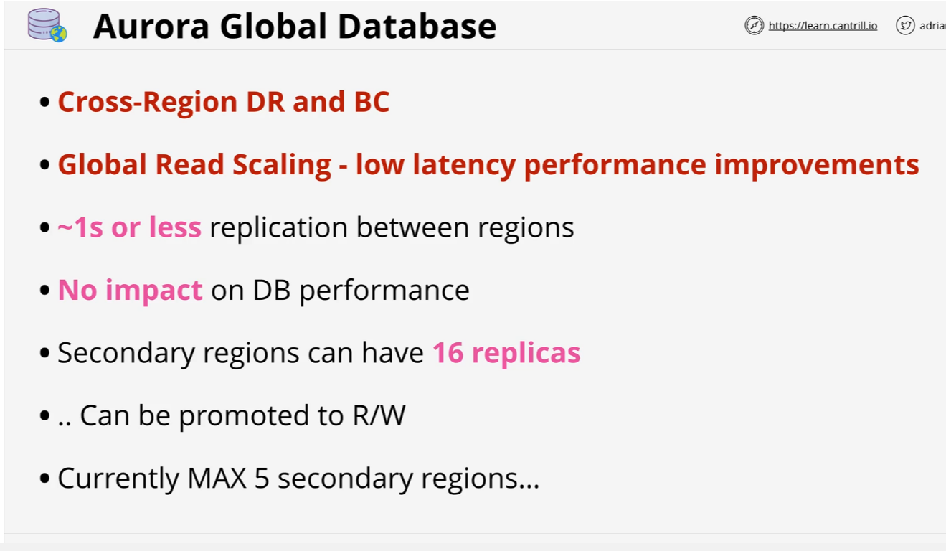
Aurora Global Database

Slide 39
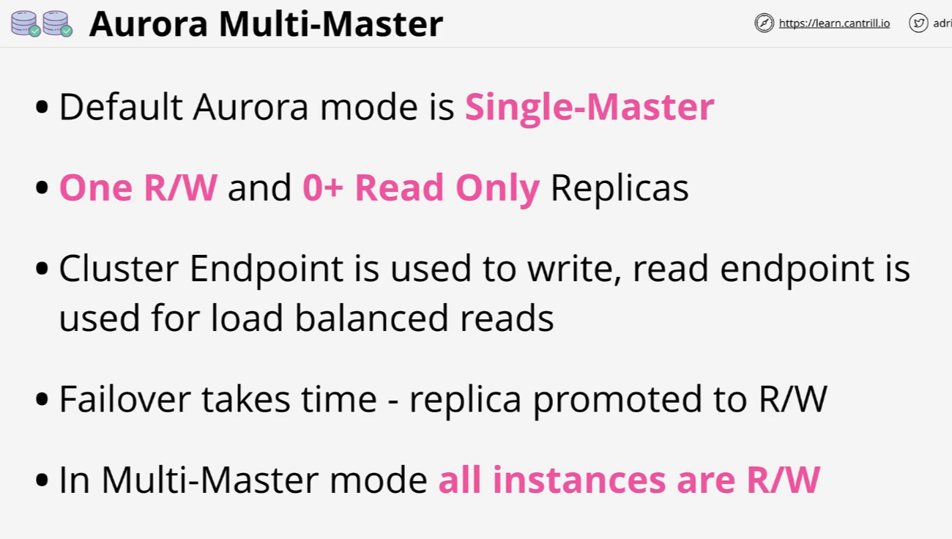
Multi-master writes

Slide 40
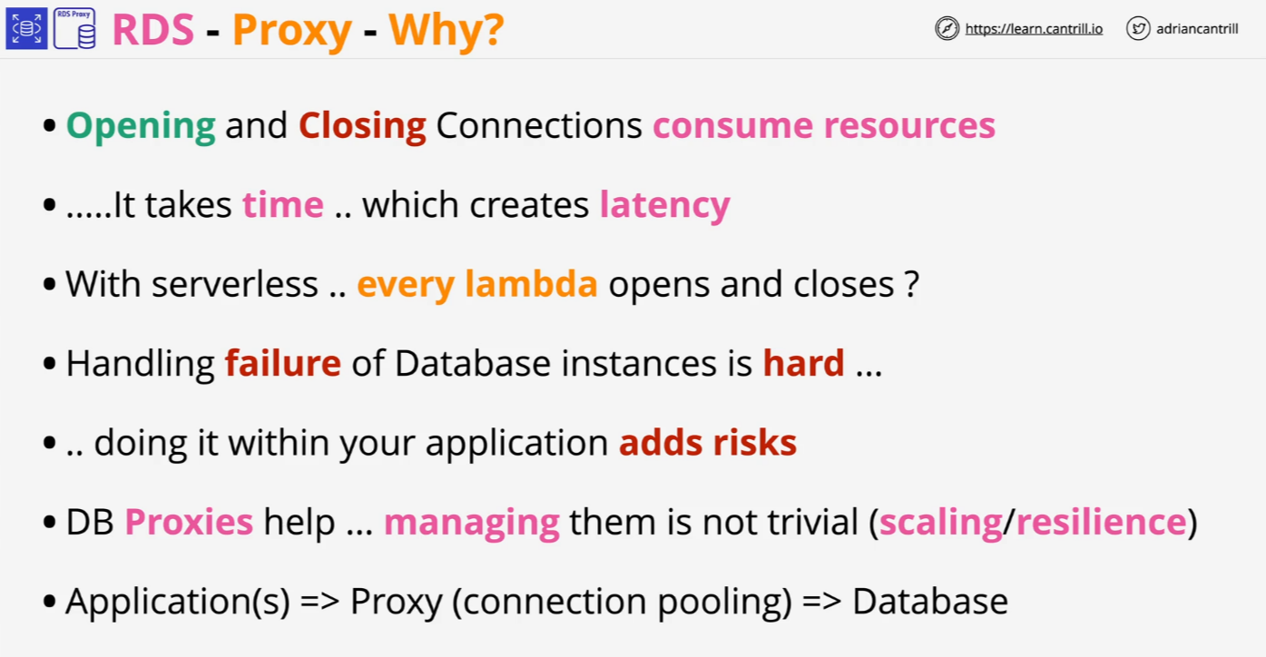
RDS Proxy

Slide 41
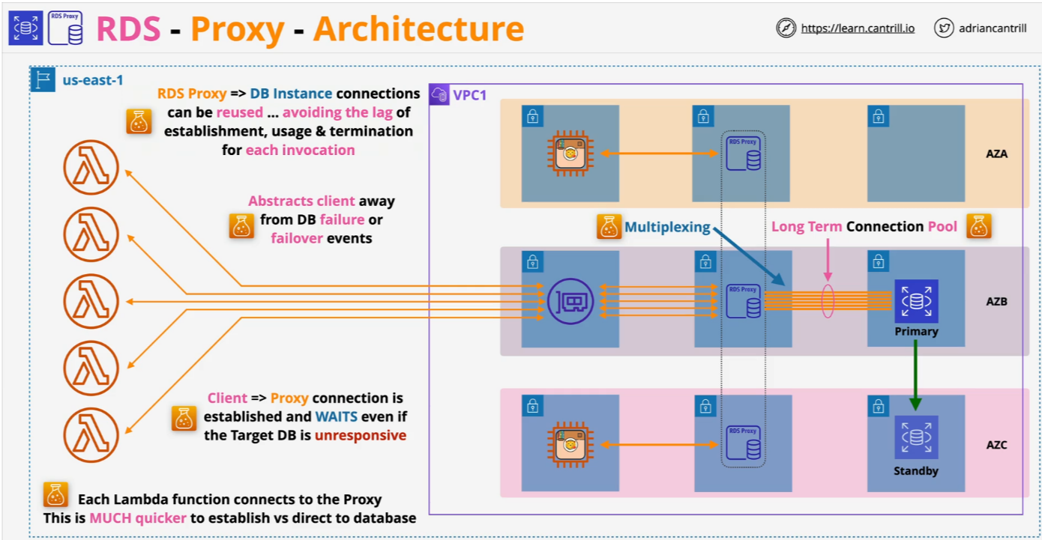
RDS Proxy

Slide 42
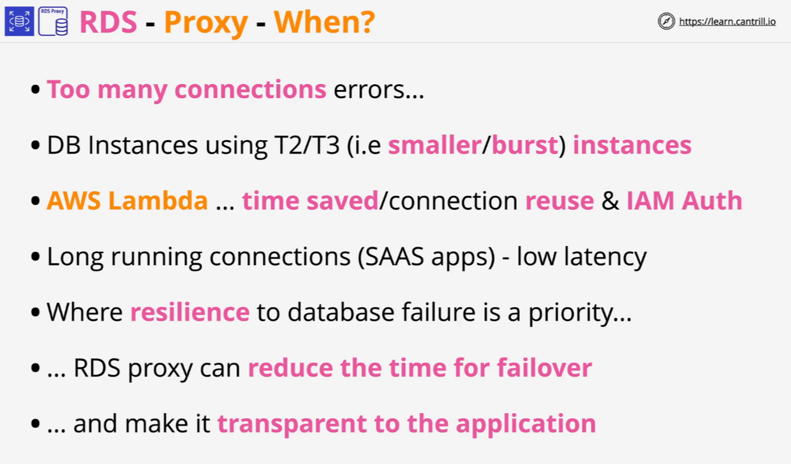
RDS Proxy

Slide 43
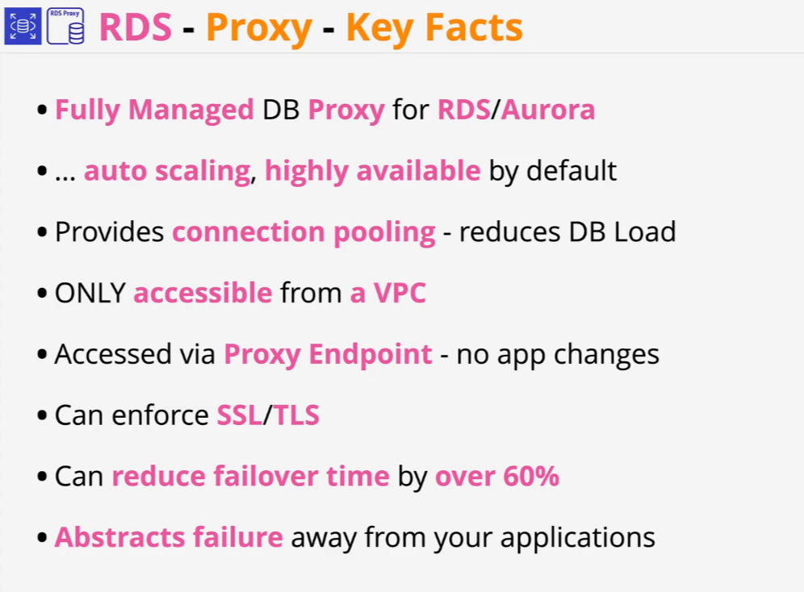
RDS Proxy

Slide 44
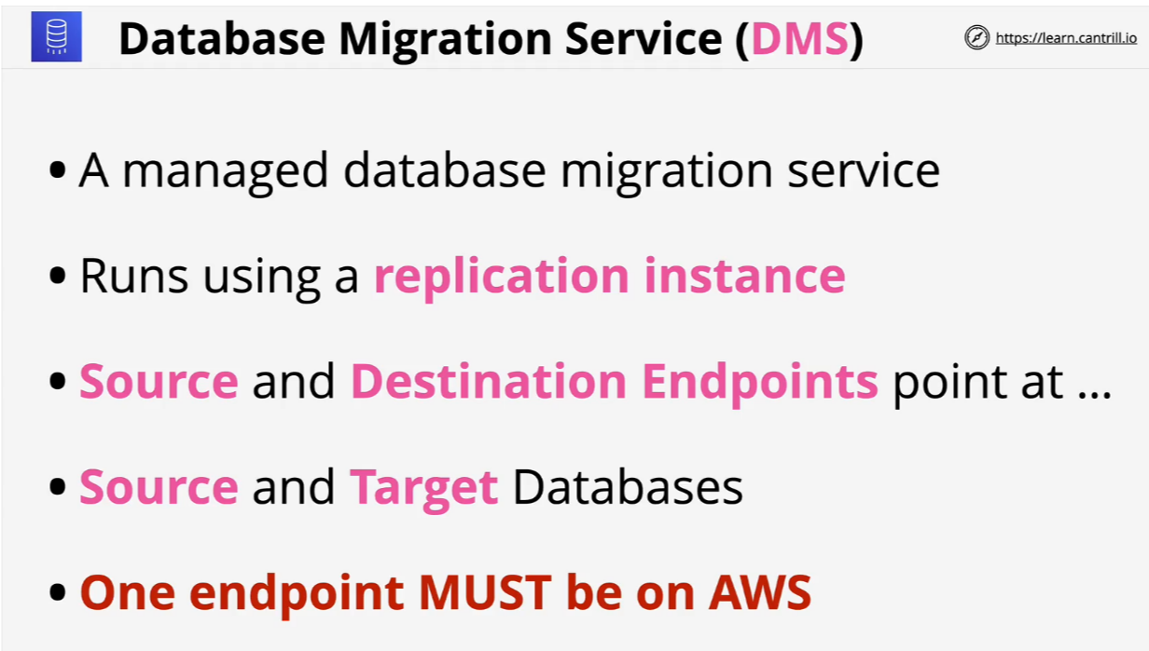
Database Migration Service (DMS)

Slide 45
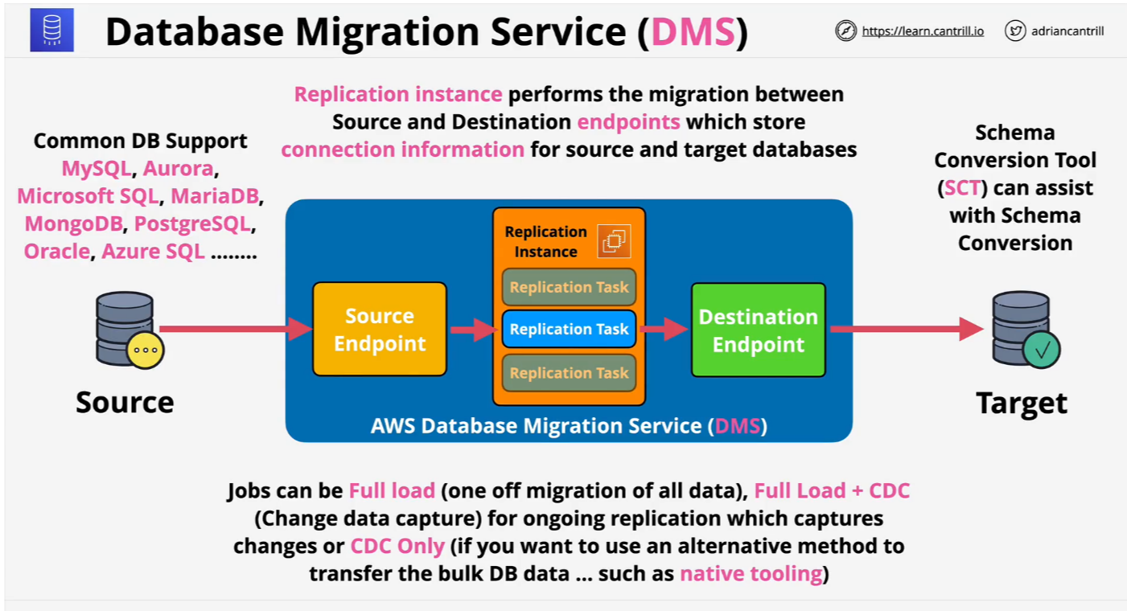
Database Migration Service (DMS)

Slide 46
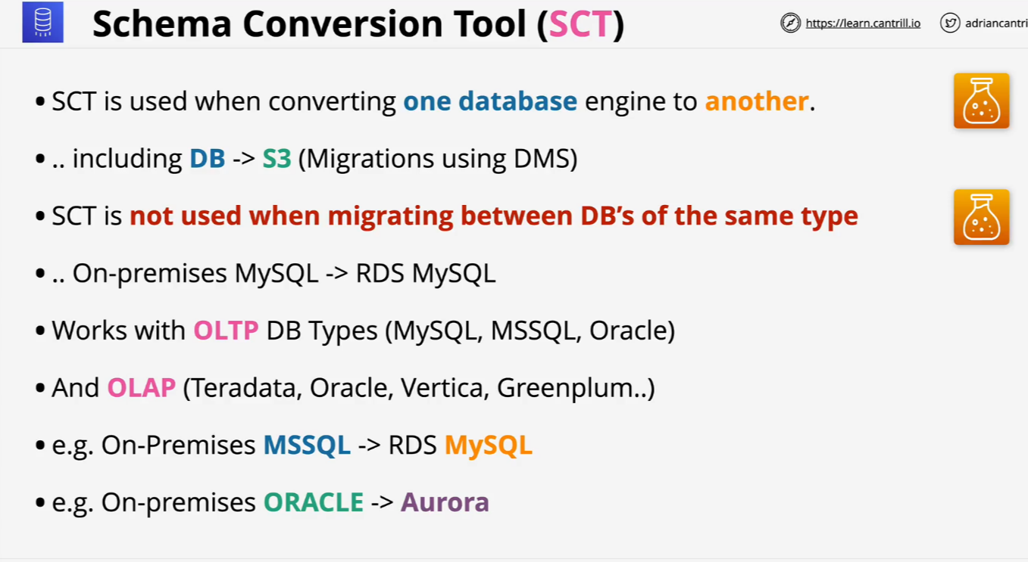
Database Migration Service (DMS)

Slide 47
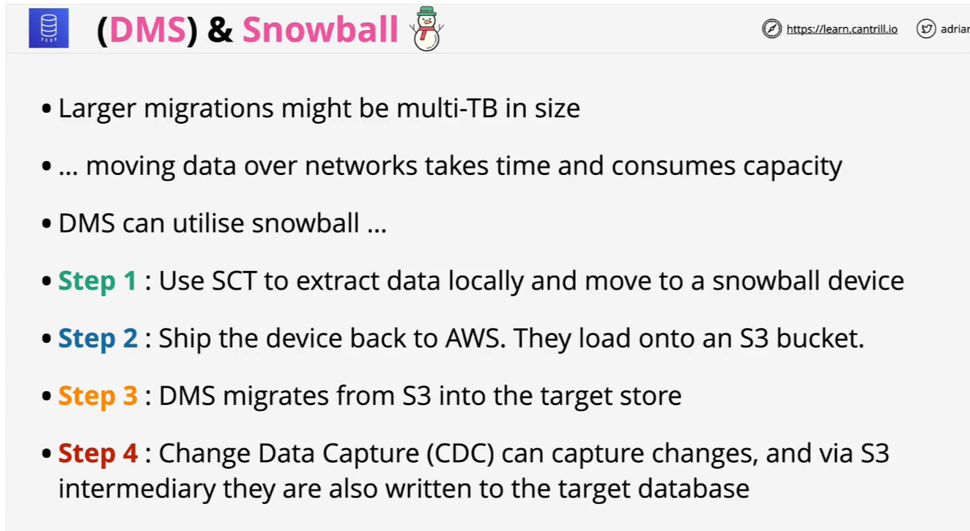
Database Migration Service (DMS)

